Slide 1
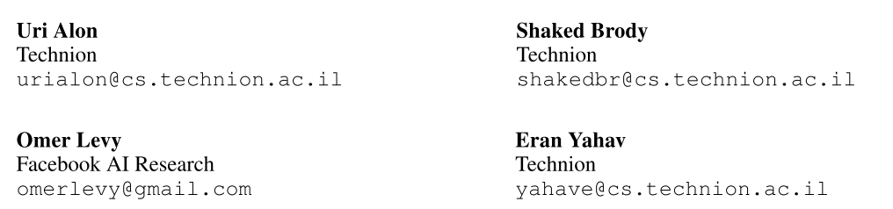
Structural Language Models of Code
ICML-2020

Slide 2
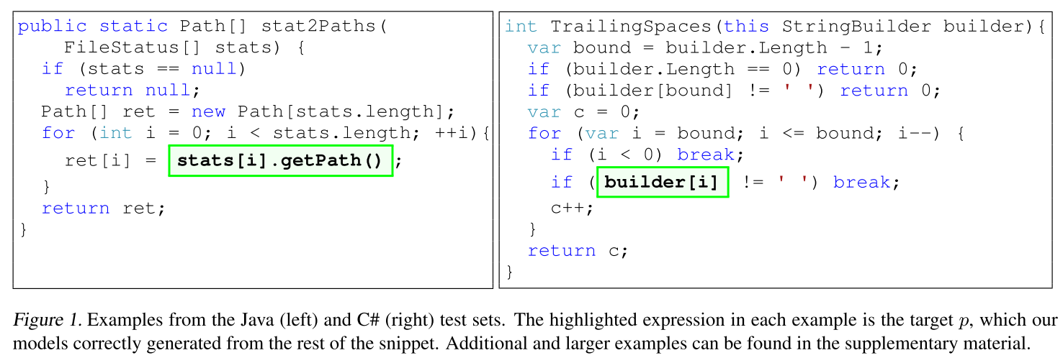
Introduction
Any-code completion: generating code in a general-purpose programming language without any restriction on its vocabulary or structure.
generating code in context: given a program$𝒫$ and some part of the program $p$, the task is to predict $p$ from the rest of the program $𝒫^{−}$=$𝒫\backslash p$

Slide 3
Introduction
We present a new approach that explicitly models the source and the target code as the same tree – structural language modeling (SLM).
SLM estimates the probability of the program’s abstract syntax tree (AST) by decomposing it into a product of conditional probabilities over its nodes.
by considering all AST paths leading to a target node, generalizing over traditional language models that consider sequences of words.

Slide 4

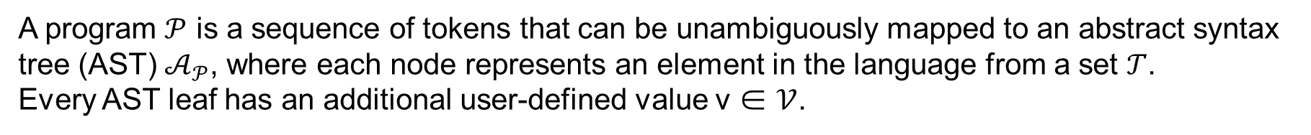
Code Generation as Structural Language Modeling
Representing Code as a Tree
A program $𝒫$ is a sequence of tokens that can be unambiguously mapped to an abstract syntax tree (AST) $𝒜_{𝒫}$, where each node represents an element in the language from a set $𝒯$.
Every AST leaf has an additional user-defined value v ∈ $𝒱$.
Decomposing the Probability of a Tree
Given a tree $𝒜_{𝒫}$, we first traverse the tree depth-first to induce an ordering over its nodes $a_{0}, …, a_{\left|𝒜_{𝒫}\right|}$∈ $𝒜_{𝒫}$
In any-code completion, part of the tree ($𝒜_{𝒫^{−}}$) is already observed. Therefore, we order the nodes of $𝒜_{𝒫^{−}}$ before
the nodes of the target p, and compute only the conditional probabilities over the nodes in p, essentially conditioning on the observed tree $𝒜_{𝒫^{−}}$

Slide 5


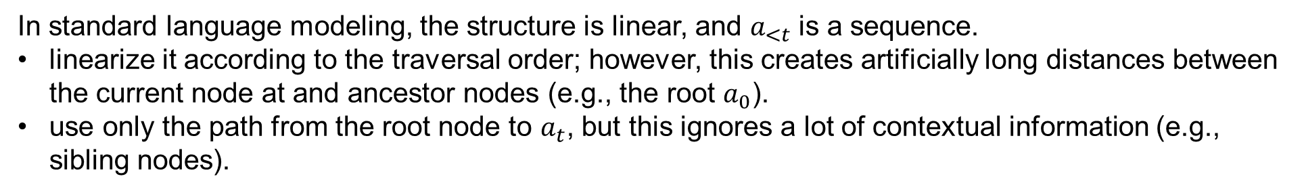
Code Generation as Structural Language Modeling
Representing Partial Trees via Paths
In standard language modeling, the structure is linear, and $a_{<t}$ is a sequence.
linearize it according to the traversal order; however, this creates artificially long distances between the current node at and ancestor nodes (e.g., the root $a_{0}$).
use only the path from the root node to $a_{t}$, but this ignores a lot of contextual information (e.g., sibling nodes).
We follow Alon et al. (2018) and use the set of paths from every leaf to $a_{t}$ together with the path from the root to $a_{t}$.
We denote the (candidate) node at time t as $a_{t}$, its (given) parent, which is currently expanded, by $π(a_{t})$, and the set of all paths as $𝒮_{t}$:
We denote the path from the root of the program as $ℛ_{t}$:
Notes:
Intuitively, each path captures the effect of a different, possibly distant, program element on at, along with the syntactic relationship between them.

Slide 6
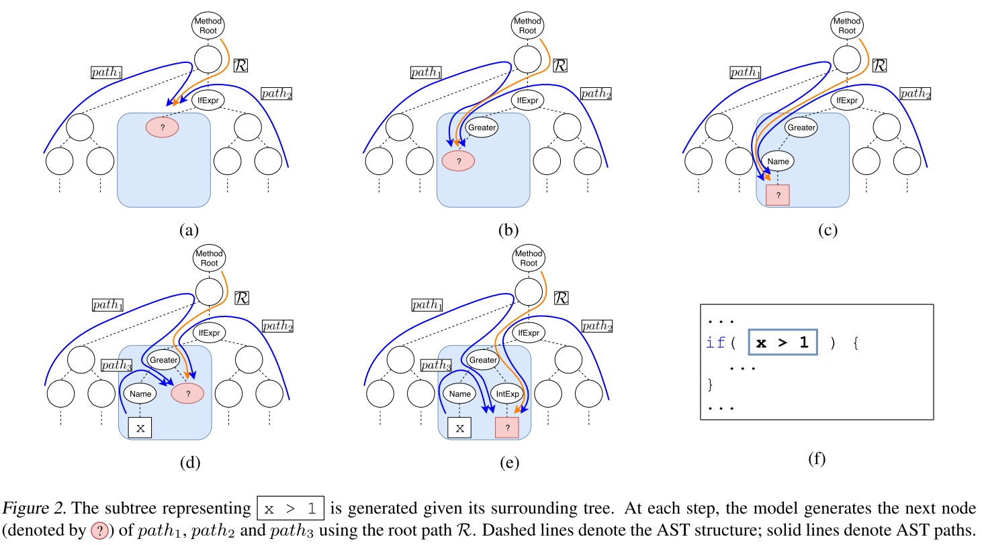
Code Generation as Structural Language Modeling
Notes:
At each step, the probability of the next node is computed given the paths St from the root and every given leaf up to the current node to expand

Slide 7
Code Generation as Structural Language Modeling
Generating Trees
We augment $𝒜_{𝒫}$ in two ways to allow node-by-node generation:
add a special EOSnode node to every nonterminal to control for arity. Generating this node indicates that the parent node has no more children.
end each subtoken sequence with a special EOStok node to control for depth during generation.
toLowerCase: to → lower → case → EOStok

Slide 8
Code Generation as Structural Language Modeling
Node Trees vs. Production Trees
Previous work predicts a grammar production rule. This representation decomposes the code in a way that often forces the model to predict with partial information.
Consider generating the expression str.Substring(3):
predict the rule Expr→Expr.Substring(Expr)
expand Expr→str and Expr→3.
the model needs to predict the method name (Substring) before the invoking object (str).
the Substring method can get either one or two arguments, forcing the model to choose whether to use the one-or two-argument rule in advance.
Notes:
Node generation, however, allows us to predict the presence of a function call and only then to predict its ob- ject and method name, rather than predicting these a priori.

Slide 9
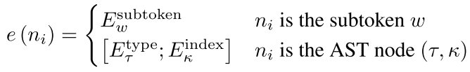

Model
Encoding AST Paths
Given a partial AST path, i.e., a sequence of nodes $n_{1}, …, n_{k}$, our goal is to create a vector representation.
A subtoken node is represented by the index of its subtoken w in the embedding matrix Esubtoken;
AST nodes are represented as a pair $n_{i}=\left(τ, k\right)$ where$τ$ is the node type, e.g. IfStatement, and $k$ is the node index among its sibling nodes.
We encode the entire path using a uni-directional LSTM stack, and take the final states:
Given a set of partial paths S, we denote their encodings as:

Slide 10
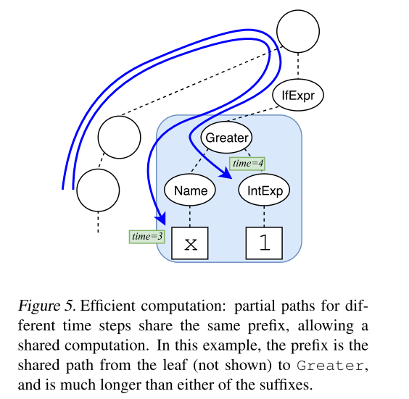
Model
Encoding AST Paths
Efficient Computation
When modeling a subtree, there are large overlaps between paths from different time steps.
We therefore apply the LSTM on the prefix once and cache the intermediate state across suffixes, speeding up both training and inference significantly.

Slide 11
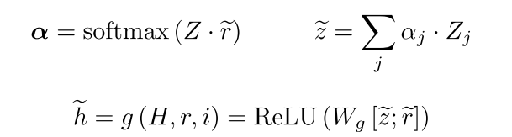
Model
Aggregating Multiple Paths
Aggregation function g (H, r, i): g takes the set of encoded paths H, the encoded root path r, and the child index i of the currently predicted child node a relative to its parent.
Notes:
parameter matrix Ci is used when the child index is i,

Slide 12

Model
Predicting with a Syntactic Copy Mechanism
Predicting AST Nodes: If a is an AST node, we predict a using a softmax over the node type embeddings Etype:
Predicting Subtokens: Programs repeatedly refer to previously declared symbols, resulting in highly repetitive usage of identifiers.
We therefore use a copy mechanism to allow our model to predict either entire tokens or individual subtokens that exist in the context.
We score each leaf $ℓ$ using a bilinear function ($W_{c}$) between its path’s encoding $H_{ℓ}$ and $\tilde{h}$
Notes:
scores scopy and sgen are then summed over all occurrences that correspond to the same symbol and subsequently normalized via softmax

Slide 13
Experimental Setup
Benchmarks
Any-Code Completion: Java
We take the Java-small dataset of Alon et al. (2019a). It contains 11 GitHub projects, broken down into a single method per example, and split to train/dev/test by project to reduce code overlap.
We create any-code completion examples by selecting every expression larger than a single AST node as the target, using the remainder of the method as the context.
remove methods containing the word “test” in their body or file name, and omit 10% of the examples by filtering out methods longer than 20 lines to avoid configurations, initializations, and auto-generated code.
remove examples where the target appears as-is in the context.
Ultimately, this dataset contains 1.3M/10k/20k train/dev/test examples.
Alon et al. code2seq: Generating sequences from structured representations of code. (ICLR-2019)

Slide 14
Experimental Setup
Benchmarks
Restricted Completion: C#
an additional benchmark where the missing code is more limited. We use the code of Brockschmidt et al. (2019a) which filters out examples where the targets contain non-primitive types or user-defined functions. Examples are extracted from the raw dataset of Allamanis et al. (2018a) using their “unseen projects test” set.
This dataset contains 30 GitHub projects broken down to one method per example. This dataset contains 16k/8k/3k train/dev/test examples.
Brockschmidt et al. Generative code modeling with graphs. (ICLR-2019)

Slide 15
Experimental Setup
Metrics
exact match accuracy at 1 and 5.
tree@k metric which counts a prediction as correct if the entire tree structures, ignoring leaf values, are identical.
Baselines
NMT: subtokenize the given code snippet, replace the target in the source with a special PRED symbol, and train the network to predict the target as a sequence of subtokens
Transformerbase+copy: uses the implementation of Open-NMT (Klein et al., 2017) with a copy mechanism (Gu et al., 2016).
Transformersmall+copy: uses dmodel = 256, dff = 1024, and 4 self attention heads per layer.
BiLSTM→LSTM+copy: is a 2-layer bidirectional LSTM encoder-decoder with d = 512 and attention.
seq2tree+copy: follows Aharoni & Goldberg (2017) and learns to generate the linearized, subtokenized target AST.

Slide 16
Experimental Setup
Baselines
Java-specific Baselines
The original implementation of Iyer et al. (2018), and also their seq2prod baseline which is a re-implementation of Yin & Neubig (2017); these are designed for NL→code tasks, in which we feed the code context as the NL input.
C#-specific Baselines
GNN→NAG using the original implementation of Brockschmidt et al. (2019a).
Bielik et al. (2016) kindly trained and tested their non-neural PHOG model on our C# dataset.
In both Java and C#, we compare to code2seq (Alon et al., 2019a), which is a strong code→NL model. We train it to generate the target code as a sequence of subtokens.

Slide 17
Experimental Setup
Implementation and Hyperparameter Settings
Architecture
embeddings of size 512
2 layers of LSTMs with 256 units
4 transformer layers with 8 attention heads
subtoken vocabulary of size 1000 to encourage the model to learn to copy (larger vocabularies did not show an improvement)
Training
train the model end-to-end on a single V100 GPU
cross entropy and the Adam optimizer
initial learning rate of 10−4 multiplied by 0.95 every 20k steps
dropout of 0.25 in the Transformer layers, and a recurrent dropout of 0.5 in the LSTMs
Inference
perform beam search with width of 5 and optimize for accuracy@1.

Slide 18
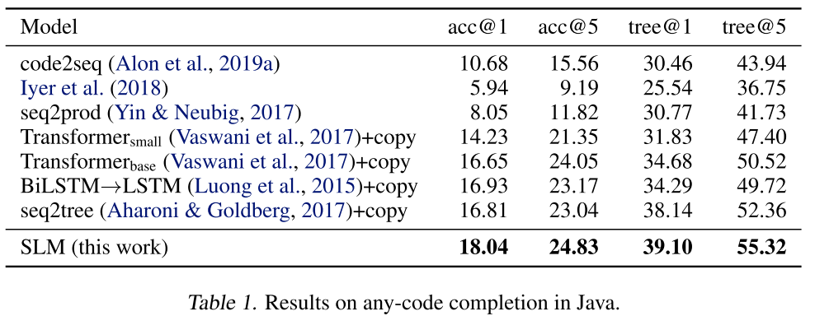
Results
Any-Code Completion: Java
Notes:
The NMT baselines performed better than code-specific baselines. the code-specific baselines are designed for different tasks:
syntactically-informed seq2tree baseline achieved the highest tree@k among the baselines, while our model achieved higher acc@k and tree@k. This shows that leveraging the syntax can benefit NMT models as well

Slide 19
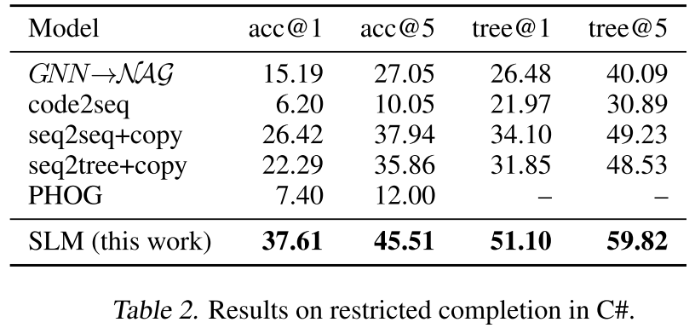
Results
Restricted Completion: C#
Notes:
GNN→NAG model could copy symbols from the context, but their (seq2seq) baseline did not.

Slide 20
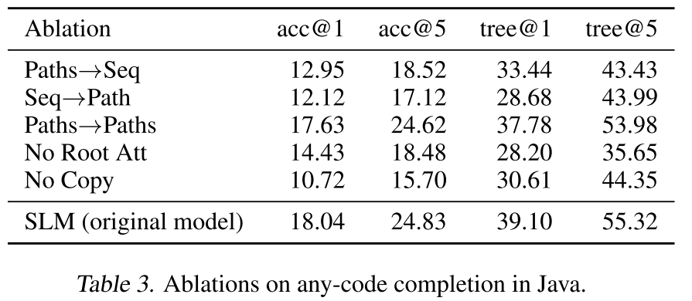
Results
Ablation Study
Paths→Seq follows code2seq (Alon et al., 2019a), where the decoder generates the target code as a sequence of subtokens. (including copy)
Seq→Path follows Rabinovich et al. (2017), where the encoder encodes the context as a sequence of subtokens using a BiLSTM, and the decoder generates the missing subtree using the root path and the index of the generated child.
Paths→Paths is similar to our SLM model except that it uses separate encoder and decoder.
No Root Attention uses max pooling instead of attention in aggregating multiple paths.
No Copy replaces copy mechanism with a much larger vocabulary (25k subtokens instead of 1k).
Notes:
SLM model performs better than Paths→Paths, shows the importance of joint modeling of the context and the target subtree by parameter tying.
Each of Paths→Paths and the seq2seq baselines (Table 1) performs better than Paths→Seq and Seq→Path; this shows the importance of using the same type of encoder and decoder for any-code completion.
Paths→Paths performs better than the seq2seq baselines (Table 1), showing the advantage of using paths over textual sequences, even without parameter tying.
Att
copy

Slide 21
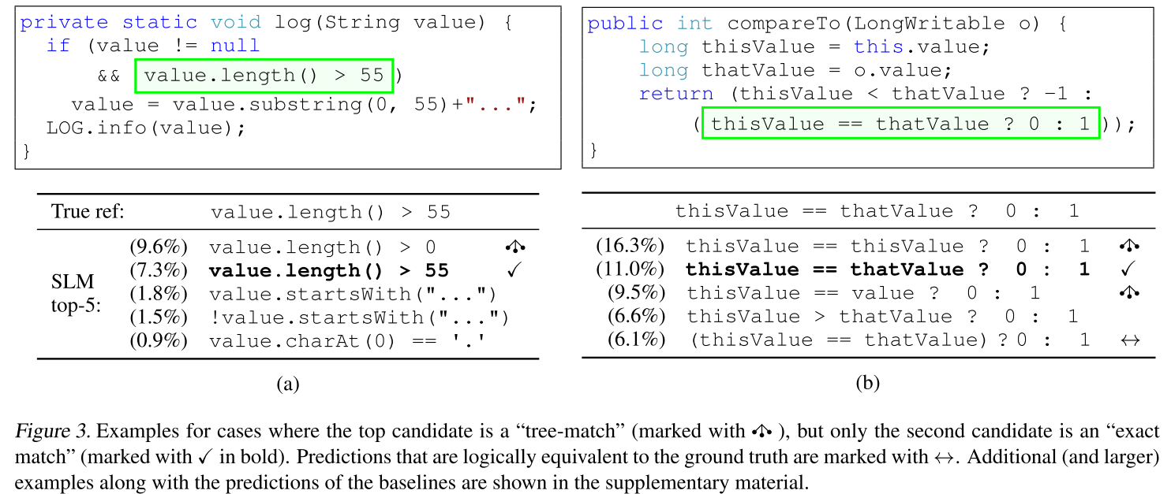
Qualitative Analysis
Notes:
Such single subtoken errors are responsible for 30% of the cases where the model’s top prediction is a tree-match but not an exact match. Single token mismatches are responsible for 74% of these cases. Thus, improving our model’s ability to predict the right names has the potential to enhance our gains furthermore.

Slide 22
Conclusion
+ Formalizing code completion as structured language modeling and extending Alon et al., 2019a for the task is natural and well executed, with strong models and significantly improved results on two code completion benchmarks for both Java and C#.
+ The authors attempted to establish comparisons with most existing code generation models.
The technical contribution is a bit limited.
Time complexity

